Slide 1
Project A COMPSYS302 Group 19
Notes:
VERY brief overview of the brief/requirements
A top-level view of how the system works (diagrams help)
Evidence that the game is a game that works
Any special features that you want the client to see (including justification)
What makes your game different to / better than everyone else’s?
Why should the client pay you (i.e. have you met the project requirements?)

Slide 2
Project Requirements
A game that blends 80s style retro computer games, and something appropriate for a twelve year old
Final product is an offline application written in Java, that can be run on Linux
Loosely based off the 1980 Atari game, “Warlords”
Should meet minimum project requirements based on previous brief (Single Player vs. AI, Local Multiplayer, etc)

Slide 3
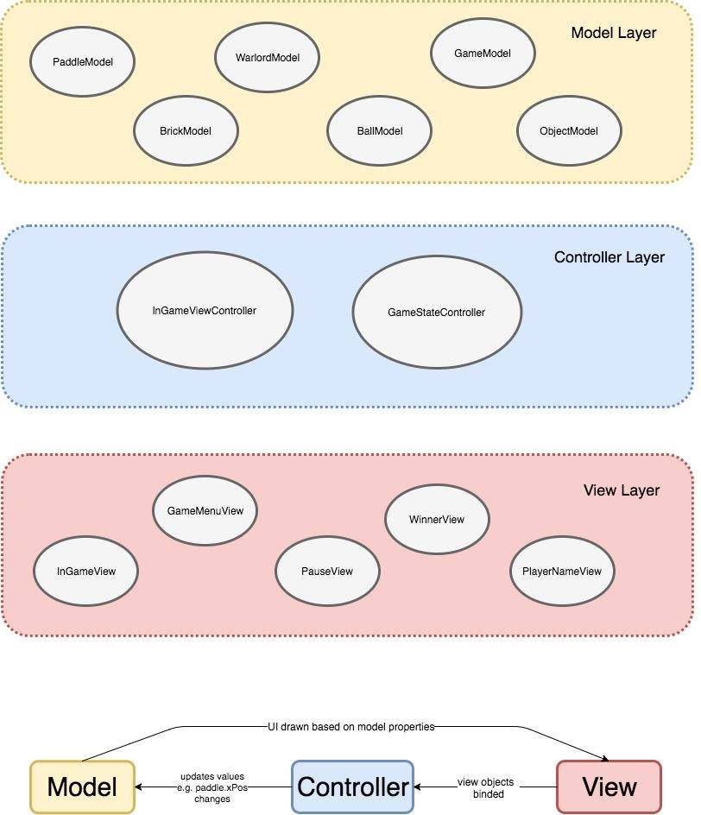
Top-level View of System

Slide 4
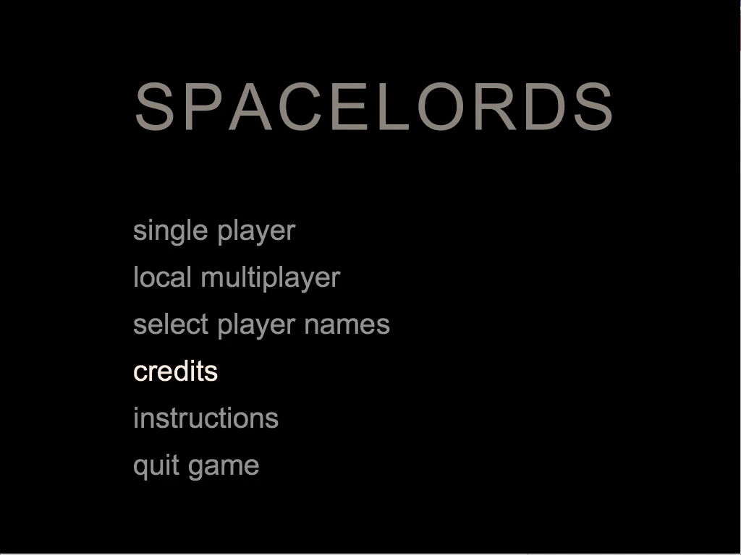
Gameplay – UI Navigation
Entirely keyboard-controlled
UP/DOWN arrow keys
ENTER to select
Cohesive
Fluid
UX
Every action has SFX
Feedback
Dynamic
(mouseover on video to play)

Slide 5
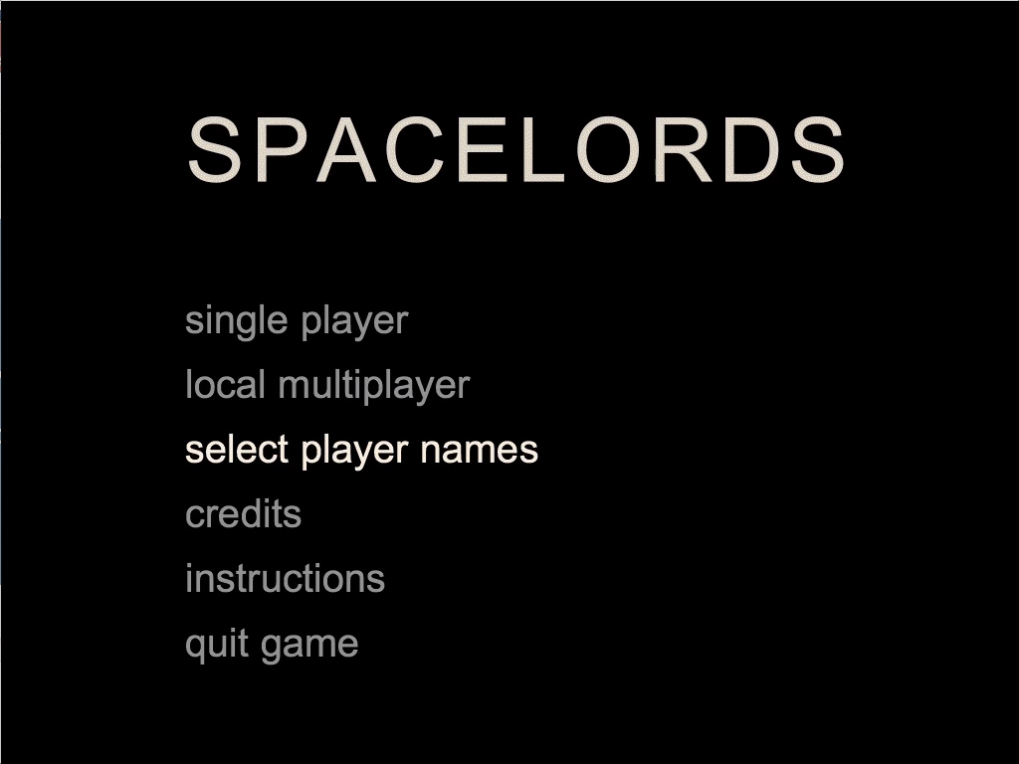
Gameplay – In Game View/Graphics
Complete game
Space theme
Countdown timer
AI
Collisions
Design decisions
HUD

Slide 6
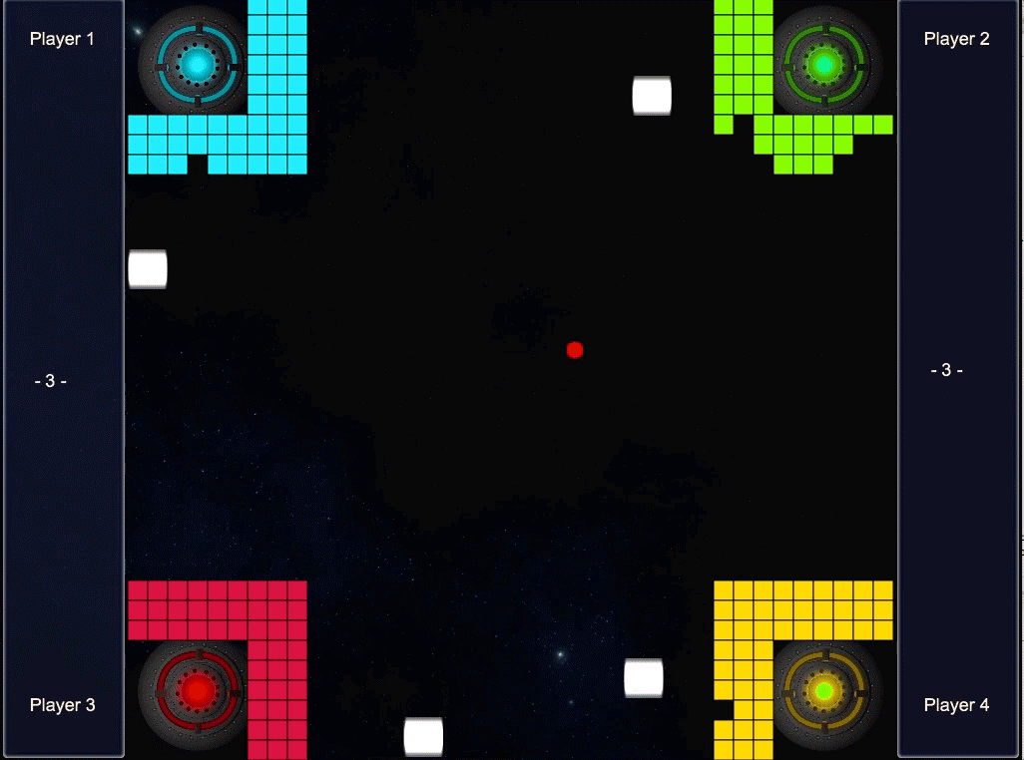
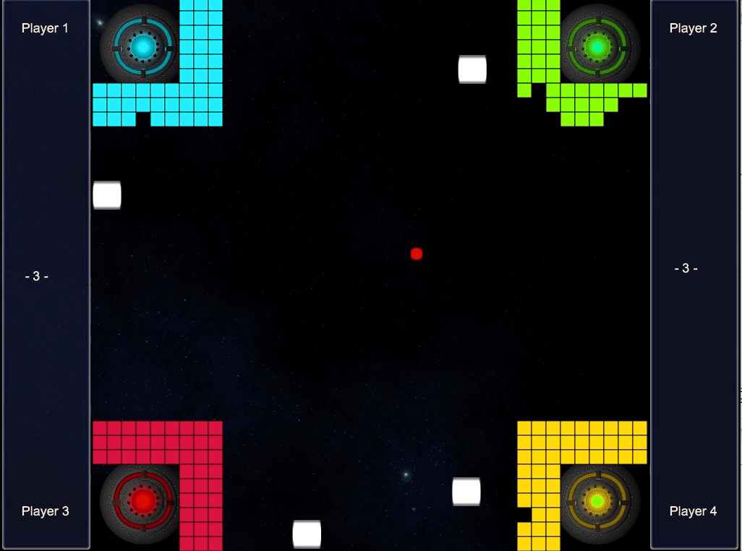
Gameplay – Summary Screen
Displays winner
Storyline progression prompt

Slide 7
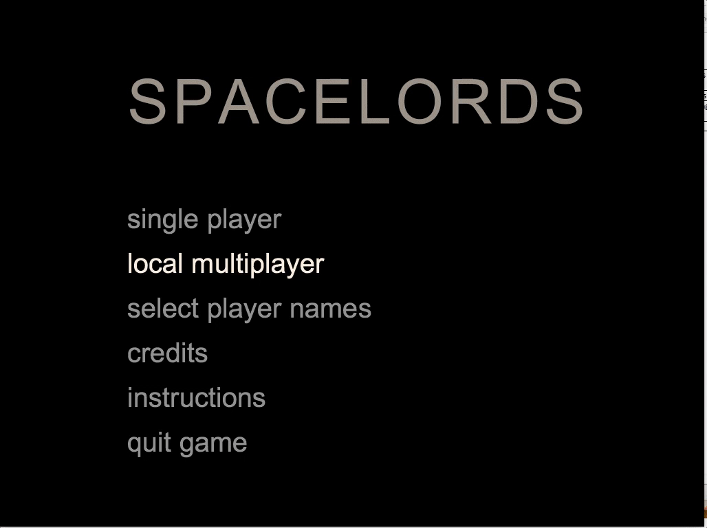
Pausing, Confirmation Windows & Justification
Full pause menu
Intuitive
Look at controls/instructions
Confirmation windows
Prevent accidentally quitting

Slide 8
Power-ups & Additional Gameplay Elements
Power-ups
Speed-up ball
Extra ball
Ball gets faster
Notes:
In order to make gameplay more interesting and separate our game from the rest, we have added powerups into the game.
They are stars which appear in the gameplay area at random time intervals. By hitting these stars with the ball, you will consume the powerup.
As the game progresses, the ball gets faster every 10 seconds.
Game more intense and faster-paced. Players now have to defend against 2 fast-moving balls

Slide 9
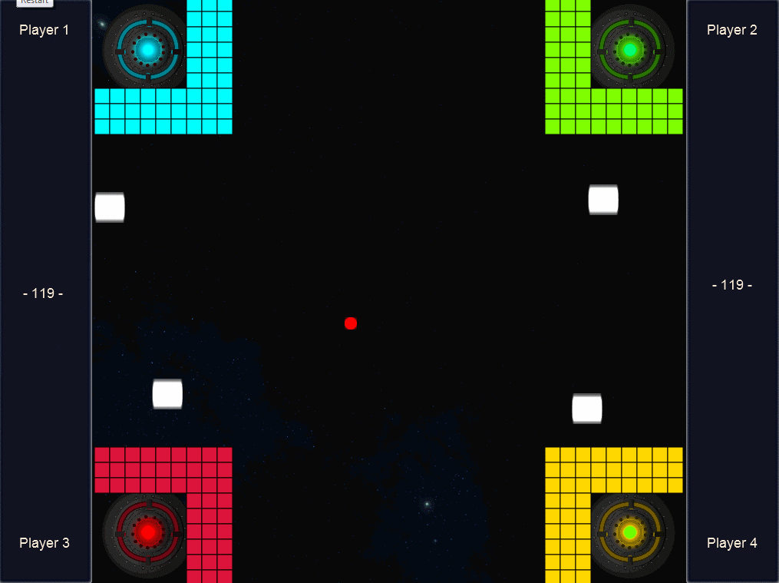
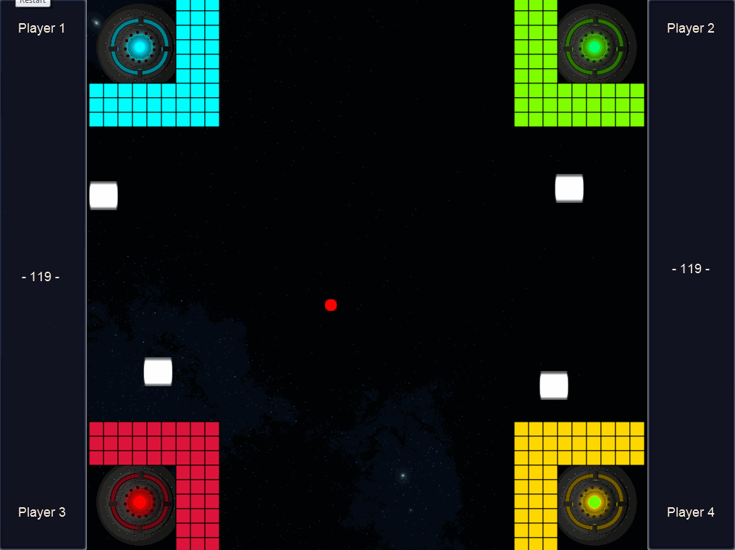
AI
Single-player mode
Formidable opponent

Slide 10
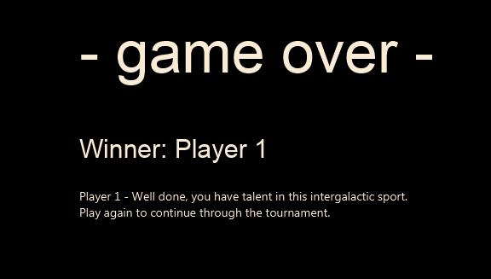
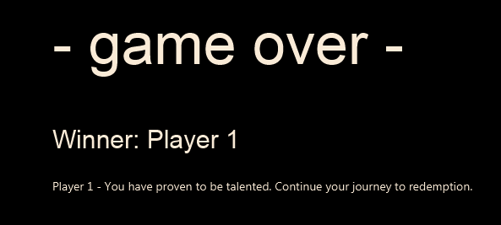
Story Integration
Backstory: Countries send out competitors to fight to the death in a tournament of Spacelords
Progress through rounds, until one winner
Excerpt aligning with story presented after each round
Notes:
The story of our game is that countries have sent out their deathrow inmates out to space to participate in a tournament of the sport Spacelords. Participants will battle it out to the death, through several rounds, until there is one remaining winner. The winner will be sent home, forgiven of their crimes and revered as a national hero. You are a wrongly-accused criminal, so it is in your greatest interest to be the winner.
Storyline progression is seen in our game in that after each round, a relevant excerpt from the storyline is presented to the player.

Slide 11
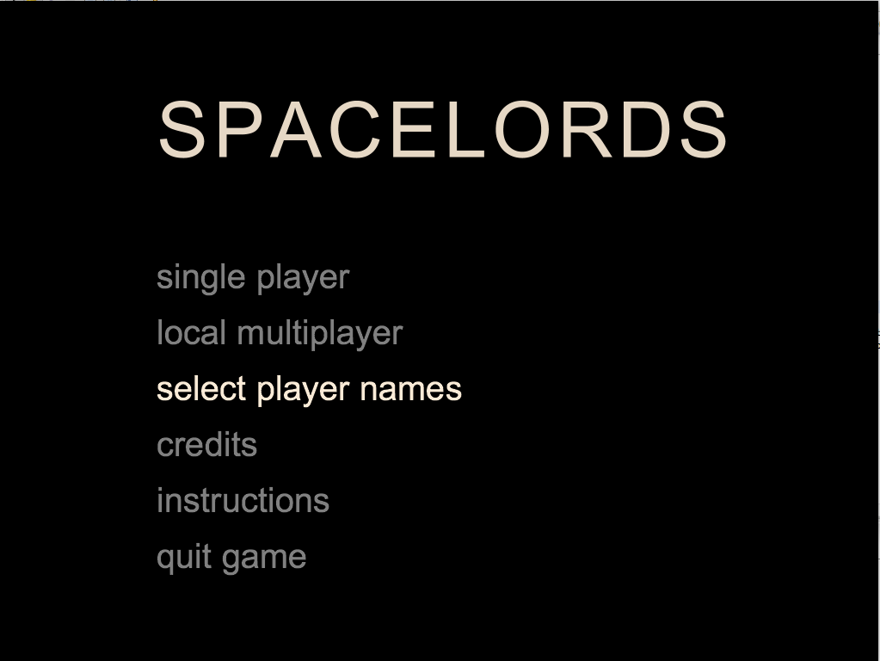
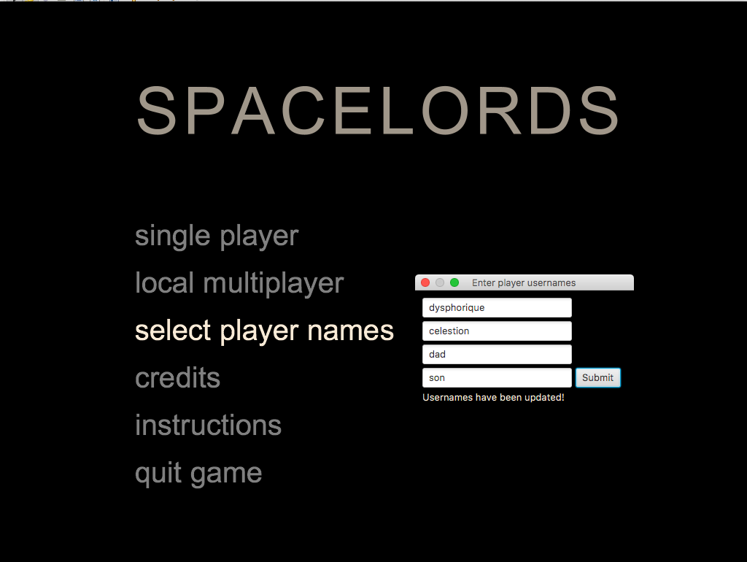
Custom Usernames & Justification
Customisation
Immersion
Notes:
To give the player some essence of customization, we give the player the option to set custom usernames.
This gives the player a degree of control over their ‘character’, allowing them to be more immersed in the game.

Slide 12
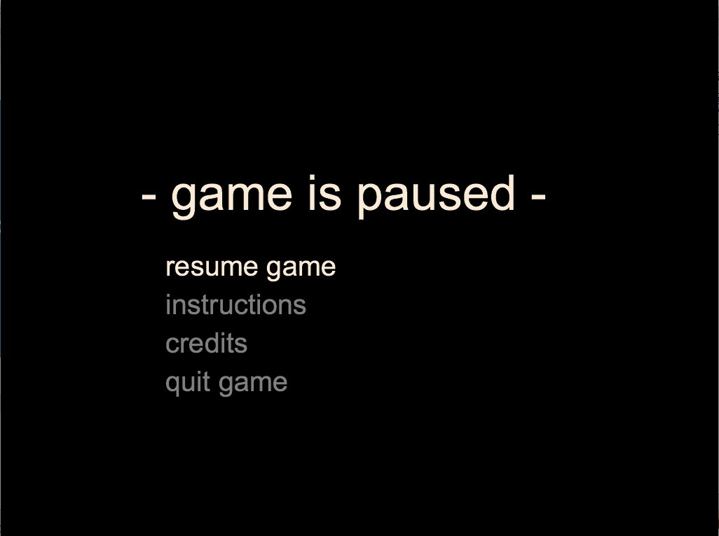
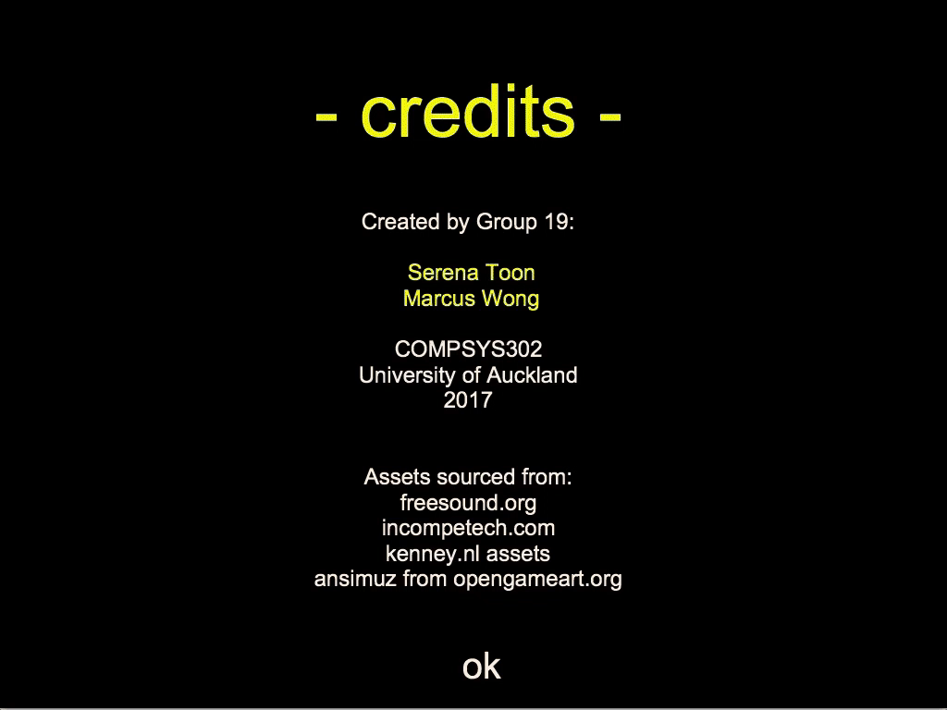
Design
JavaFX platform
Industry standard
Newer than its alternative, Java Swing
More powerful
Range of effects
Notes:
We have chosen to go with the JavaFX platform to develop our game as it is the industry standard.
It is much newer than the alternative, Java Swing, and is a lot more powerful.
These are some menus that were made with JavaFX.

Slide 13
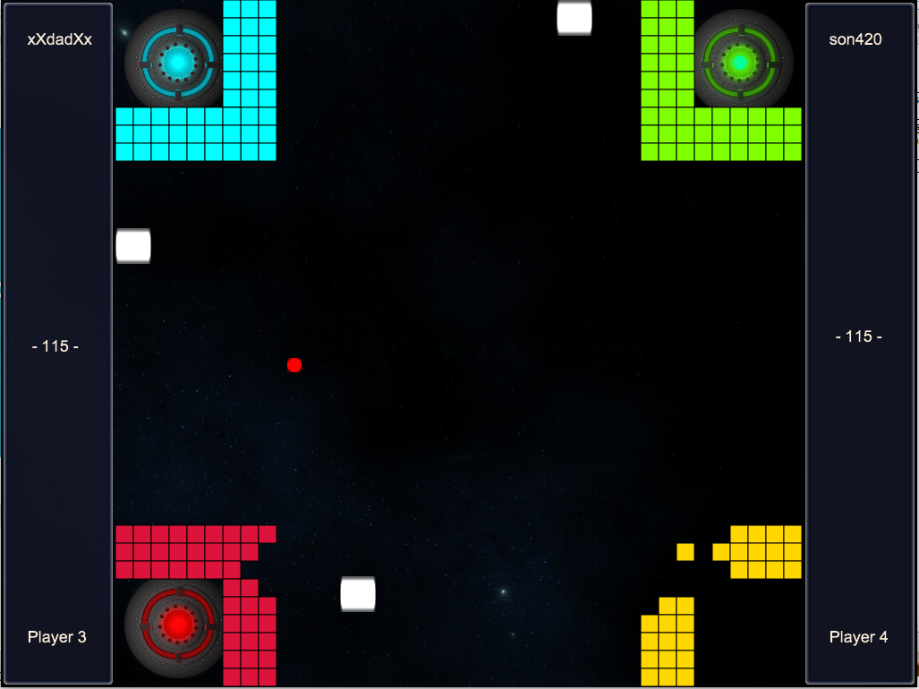
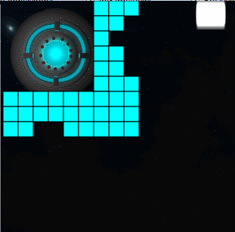
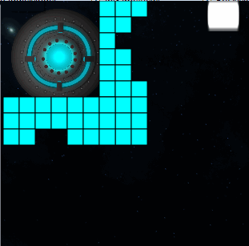
Design
HUD
Display important info
Player names
Square gameplay area
All elements are squares
Adapt paddle path
Curved
No sharp corner turns
Notes:
From this, we have gone with design decisions such as having the HUD on the sides to display important game information.
This opened up room to display player names, which as mentioned, offers customisation to the player.
Having the HUD, the gameplay area is now a square. To go along with this, all elements of our game are also squares or perfect circles. This includes the movement of the paddle. It moves along a curved path and does not make any awkward sharp corner turns.

Slide 14
What makes our game different?
Space theme
Retro, nostalgic graphics + sound
Updated modern graphics
Extensive use of sound for every action, provide feedback
Fluid navigation
Only keyboard
Fair local multiplayer
Unique gameplay
Notes:
A space aesthetic which combines retro, nostalgic sounds with updated modern graphics
Fluid UI navigation, coupled with additional gameplay elements which make the game fun and engaging
Extensive use of sounds, both in game and in menus to allow for a more dynamic experience
Entire game can be experienced purely on keyboard as all menus are navigated with keyboard, use of mouse click buttons kept to a minimum. Useful for large groups

Slide 15
Summary (Why should you pay us?)
A unique aesthetic
All minimum project requirements implemented fully
Lots of quality of life improvements and additional features, as seen in the previous slides
A game both you and your son can enjoy together

